Slide 1
Algal Classification

Slide 2
Introduction
Algae comprise a group of autotrophic, chlorophyll containing thalloid plants of simplest type having no true root, stem and leaves.
Habitat ranges from freshwater, marine, soil, lichens,
limestone, polar ice etc

Slide 3
International Code of Botanical Nomenclature
Like all plants, the algae are classified in accordance with the
International Code of Botanical Nomenclature.
This code recognizes the individual organism as it belonging to :
Division
2. Class
2a. Subclass
3. Order
3a. Suborder
4. Family
4a. Subfamily
5. Genus
6. Species

Slide 4
Suffixes recommended by the International Code of
Botanical Nomenclature are:
1. Division – phyla
2. Class - phyceae
➢ Sub-class - phycideae
3. Order - ales
➢ Sub-order - inale
4. Family – aceae
➢ Sub-family – oideae
5. Genus - a Greek Name
6. Species - a Latin Name

Slide 5
CRITERIA FOR ALGAL CLASSIFICATION
The primary classification of algae is based on following five criteria:
Photosynthetic pigments
Nature of reserve food material
Nature of cell wall component
Type, number and attachment of flagella
Cell wall

Slide 6
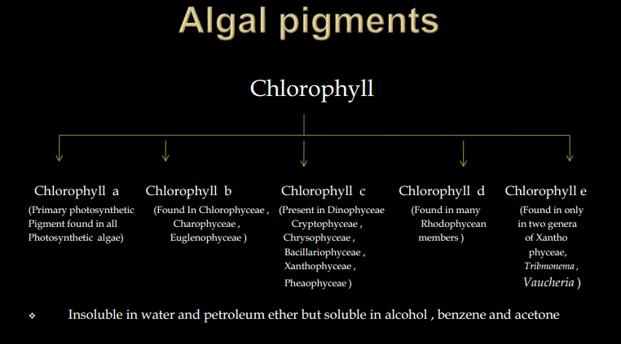

Slide 7
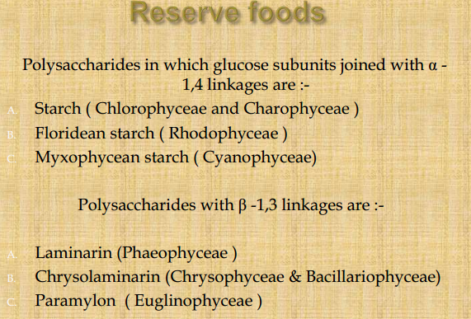

Slide 8
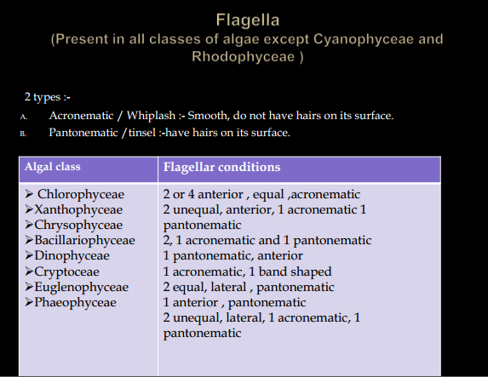

Slide 9
IMPORTANT SYSTEM OF CLASSIFICATION
Smith’s system of classification
Fritsch’s system of classification
Classification proposed by Papenfuss
Classification by Prescott
Round’s system of classification
Chapman and Chapman system of classification

Slide 10
Smith’s system of classification
Classified algae into 7 divisions and divisions into
different classes on the basis of :-
Physiology of vegetative cells.
Morphology of motile reproductive cells .
Reserve foods.
Photosynthetic pigments.

Slide 11
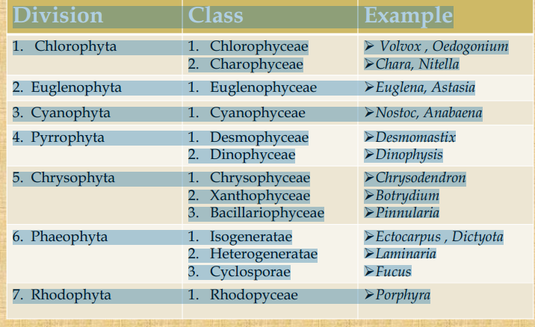

Slide 12
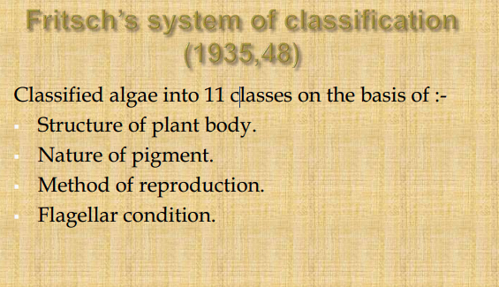

Slide 13
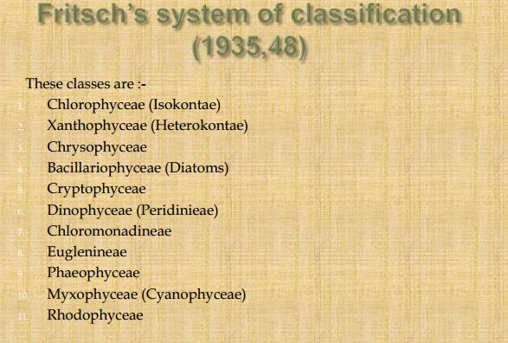

Slide 14
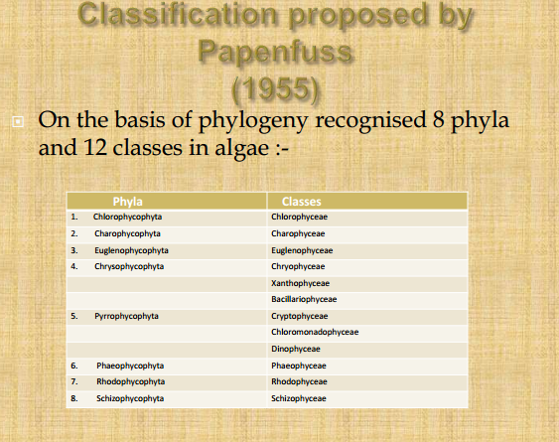

Slide 15
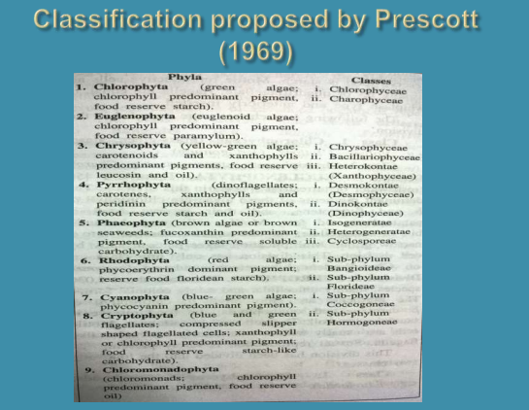

Slide 16
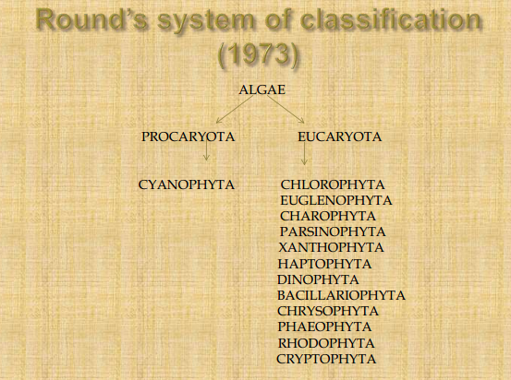

Slide 17
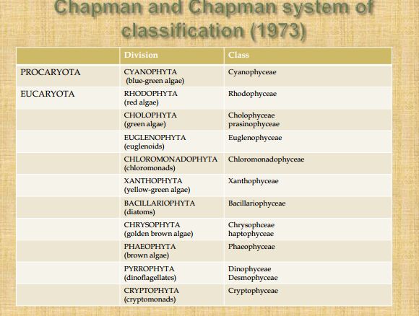

Slide 18
Source:
Book by S. Chand Publication
Slideshare.net

